Slide 1

Municipal Safety Programs
Will Strength

Slide 2
What is Safety?
Safety -The condition of being protected from or unlikely to cause danger, risk, or injury.
Safety Culture - a term often used to describe the attitudes, beliefs, perceptions and values that employees share in relation to safety.

Slide 3
Basic Elements of an Effective Safety Program
Management Commitment
Assignment of Responsibility
Accountability
Hazard Identification and Control
Employee Involvement
Accident Investigation
Evaluation

Slide 4
Management Commitment
Management commitment provides the motivating force and resources for organizing and controlling activities within your organization.
Visible top management involvement in implementing a program is essential.

Slide 5
Management Commitment
A written safety policy that clearly states expectations for supervisors and employees.
Allocation of resources to achieve safety expectations
Job descriptions that define safety as a responsibility. Ensuring employees understand that fulfilling those responsibilities is a condition of employment.
Notes:
**Examples of commitment are

Slide 6

Get Top Management Involved
There is usually only one way to get top managements’ support and make safety a core value for your organization.
Talk Dollars and Cents!!!
Notes:
Explain the cost of your Workers Comp premium
Explain the time taken to investigate and report accidents, show how much this costs
Report the cost of property damage from accidents, the cost of replacement employees, the amount of time taken off work

Slide 7
HIDDEN COSTS
Disruption of operations or delays in completing projects
Impaired ability to respond to requests for service
Equipment loss, or loss of use
Shaken public confidence
Reduced employee morale
Notes:
If you can’t get the support of your Mayor or Manager, your going to have a really tough time getting --- the support of your co-wokers, the time necessary to training, its going to be a struggle to be successful, just do the best you can.

Slide 8
Assignment of Responsibility
Delegate to key personnel
Proper selection of a Safety Coordinator.
Emphasize to employees their responsibilities
Notes:
Who are your key personnel? Who should be your safety coordinator?
Obviously for each organization this will vary. It may be the Mayor or Clerk in some cities--- especially the smaller towns
Could be your Police Chief, Fire Chief, Public Works Supervisor, Any supervisor---- Does it have to be a manager or supervisor? No, but hopefully individuals that have made it to these positions have done so because they are mature, responsible, motivated, hard working employees. They are already leaders or they should be. They already have necessary authority and leadership skills required of a safety coordinator.
Safety coordinators aren’t the only employees that should be assigned responsibility?
Each person in your organization, no matter what his or her function, has some responsibility for health and safety. Assign responsibilities, set these out
in writing to ensure that they are understood, and hold the appropriate persons accountable.

Slide 9
Responsibility
Managers’ responsibilities may include
the following:
Identify and control hazards
Ensure that work practices and procedures are understood and observed
Train employees

Slide 10
Responsibility
Investigate all accidents to determine the causes, and what corrective action is needed
Maintain equipment, machinery, tools, etc., in good working condition
Conduct regular health and safety inspections

Slide 11
Employee Responsibility
Make sure that workers understand their responsibilities. These include
Complying with safety rules, work practices, and procedures
Use protective devices and safety equipment properly
Report all hazards to their supervisors
Report all accidents immediately

Slide 12
Accountability
Strengthen accountability by doing the following:
Develop and enforce a written disciplinary policy that has clear workplace safety expectations for all employees.
Hold supervisors responsible for developing proper attitudes for workplace safety and health, for enforcing safety and health rules, and for the safety record of those they supervise.

Slide 13
Accountability
Include employees’ safety and health responsibilities in their job descriptions and performance evaluations. Ensure that they understand fulfilling those responsibilities is a condition of employment.

Slide 14
Hazard Identification
EXAMPLES OF COMMON HAZARDS
Housekeeping and Sanitation
Tools and Equipment
Material Handling and Storage
Motorized Vehicles
    Accidental Impact and falling objects
Walking & Working Surfaces
Noise, Vibration, Sharp Objects

Slide 15
Hazard Identification and Control
Conduct a baseline hazard survey.
Perform regular safety inspections.
Watch for hazards.
Look for new hazards whenever you change equipment, materials, or work processes.
Enforce safety and health rules and work practices.

Slide 16
Hazard Identification and Control
Use material safety data sheets to identify chemical hazards.
Know when and how to use personal protective equipment.
Practice good housekeeping.
Maintain equipment on schedule
Prepare an emergency response plan.

Slide 17
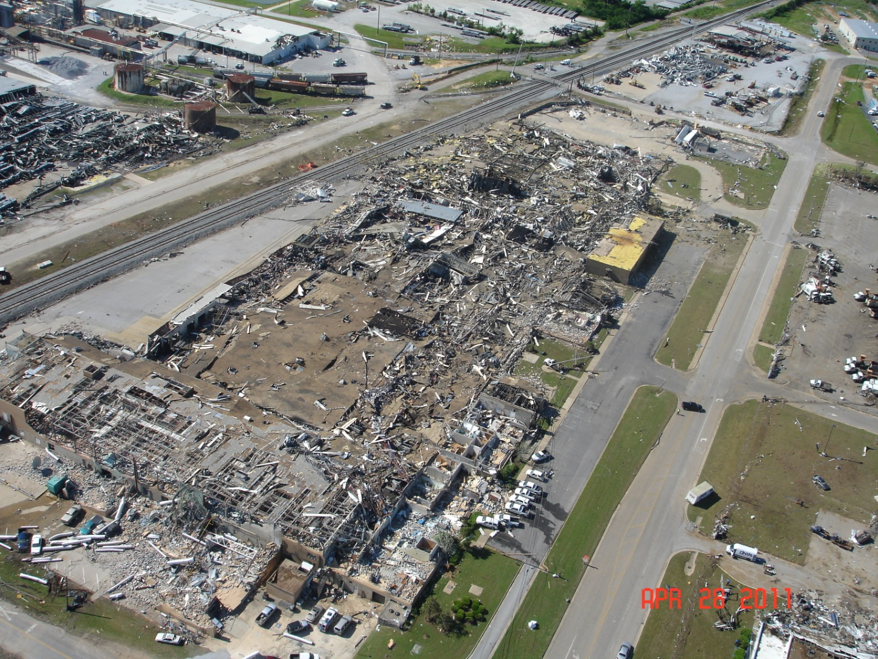
Emergency Plan

Slide 18
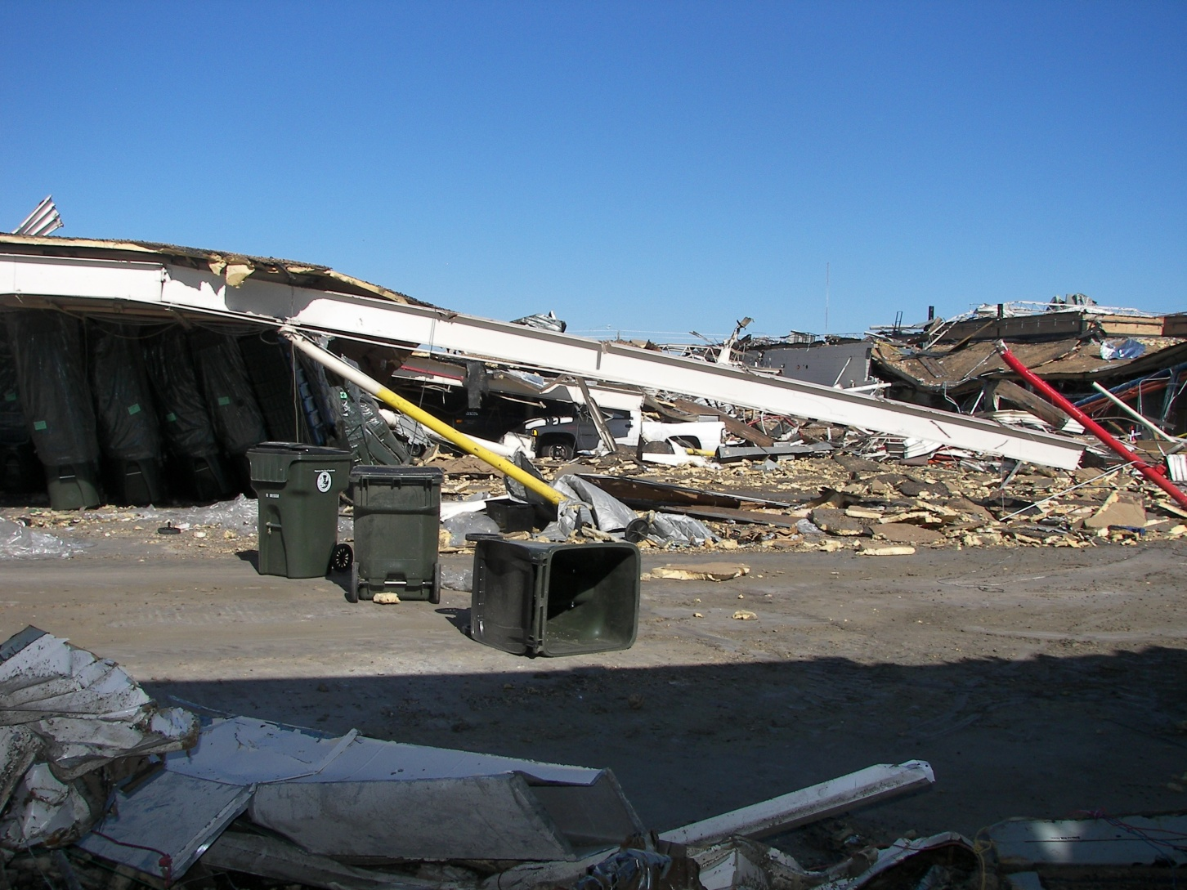
Emergency Plan

Slide 19
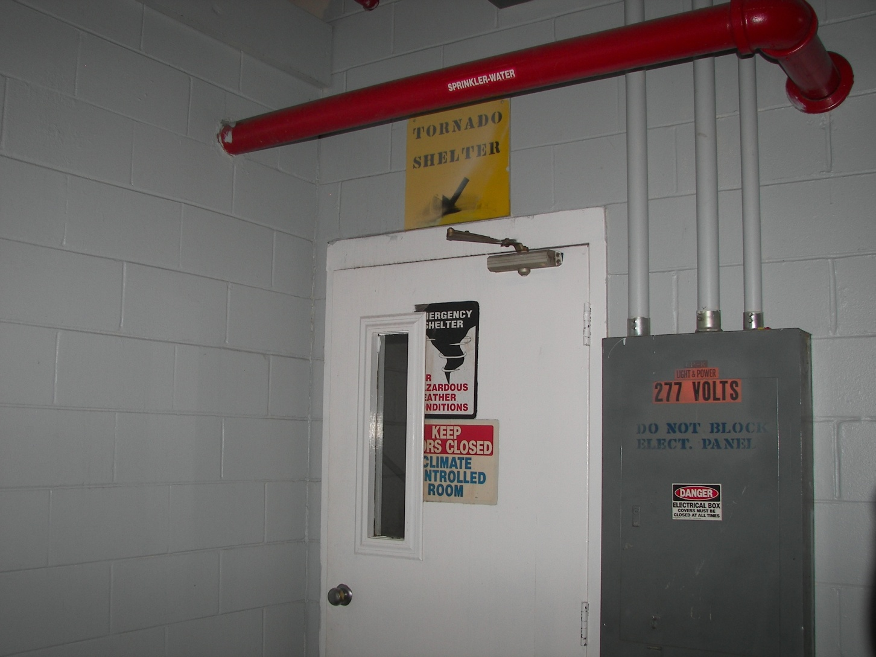
Emergency Plan

Slide 20
Employee Involvement
Safety Training
Safety Meetings
Safety Incentive Programs
Safety Awareness
Safety Committees
Wellness Programs
Notes:
***The 5th element of safety program is
Management commitment and employee involvement are complementary. Safety cannot be managed effectively unless employees are involved in the day-to-day effort to keep the workplace safe.
Employee involvement provides the means through which workers develop and express their own commitment to worksite safety.
Some of the best ways to get them involved is by having them attend safety …..

Slide 21
Meeting vs Training?
  Safety meeting:
    Excludes NO employee or group
    Applies to ALL attendees
    Educational
    Provides information
    Usually in the classroom setting
Notes:
Can anyone tell me the difference between safety meetings and safety training?
A safety meeting includes ALL employees at ALL levels. Meaning…the topic of the safety meeting applies to all whom are present. IE: heat exhaustion topic in May or June, Sexual Harassment awareness, Road Rage Awareness

Slide 22
    Safety Training
    Focuses on skills development-- “how-to-do” a task
    Task-specific
    Usually performance-based
    All P-B training is measurable or observable

Slide 23
PURPOSE OF MEETINGS
PROMOTE SAFETY AWARENESS
  MOTIVATION OF EMPLOYEES
  SHARING OF IDEAS & SUGGESTIONS
  DISCUSSION OF SAFETY STANDARDS
  ESTABLISH COMMUNICATION
  DEMONSTRATES MANAGEMENT’S CONCERN FOR SAFETY

Slide 24
SAFETY MEETING OBJECTIVE
Change unsafe acts and/or unsafe conditions
Provide information
Introduce new materials, machines, or processes
Report of past injury experience.
To conduct policy orientation
Notes:
.

Slide 25
Meeting Presenters
Employee
Supervisor
Department Head
Safety and Health coordinator
Outside speaker
Notes:
.

Slide 26
SAFETY MEETING TOPICS
Recent accidents ( high frequency)
High Risk Jobs
New machinery or equipment
Observed unsafe acts by employees
Motivational subjects

Slide 27
SAFETY MEETING REFERENCES
MWCF/AMIC Video Library
Public Libraries
Internet
Newsletters
Outside speakers

Slide 28
ATTENDANCE
Strive for 100%
  Mandate attendance from all employees
  Management should attend all meetings
  Department/Agency head shall attend 100% of meetings
  Plan for mid week meetings/training

Slide 29
DOCUMENTATION OF MEETING
Should include:
  Date
  Topic(s)
  Attending employees original signatures
  Instructor’s name and signature
  Teaching aids used
  Total # of employees on staff
  Total # of employees attended
Notes:
Teaching aids can include: name of video, websites or resources for handouts
Total # of employees on staff need to be able to be verified if the LPO asks during the audit, best source will be from ISIS payroll.

Slide 30
Safety Incentive Programs
Employee Safety Incentive Programs encourage and recognize employees for improved performance, and motivates them to maintain stellar safety records
Notes:
This another element of your safety program, Incentive programs do not replace poor safety management. A safety incentive program is successful when the organization already has implemented a good safety program. An effective safety incentive program encourages employees to exceed the expectations of a safety management program. Incentives can be very simple such as
Recognition
Time Off
Special Assignments
Gift Cards
Lunches
Prizes such as umbrella, handbags, apparel, ppe
Anything can be used but you’ll have to decide what is best for your organization.

Slide 31
Safety Awareness
Safety Awareness -is simply any method used that is designed to constantly remind employees to work safely.
Safe work environment posters
Newsletters
Regular safety emails
Posting number of days without accidents
Posting awards and certificates

Slide 32
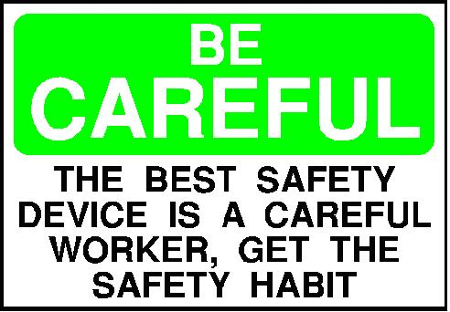

Slide 33

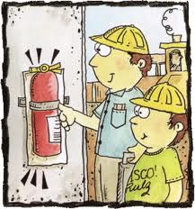
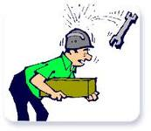

Slide 34
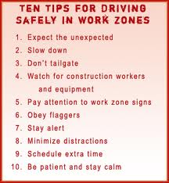

Slide 35
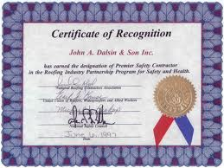

Slide 36
Safety Committees
Committee Functions
Examine safety & health issues and recommend policies.
Conduct periodic workplace inspections.
Evaluate and promote interest in the safety program.
    Education and training
Problem Solving NOT Problem Giving

Slide 37
Forming a Committee
Determine the size and structure of your committee.
Determine who the committee members will be.
Get Top Management Involved

Slide 38
What makes a safety committee meeting a disaster?
Lack of participation
Lack of organization
Same old things reviewed over and over
There is talk, talk, talk…without decisions
Just a complaint session
People do not show up for meetings and inspections.
People don’t know why they are there
Lack of support from management
Lack of time to perform committee duties

Slide 39

Basic Meeting Procedures
To be effective, Your Safety Committee needs to do the following:
Establish a regular, published meeting time,
date and if possible, place.
Take meeting minutes and distribute to members and department heads.
Have a written agenda.
Start and end meetings on time.
Publicize the Committee’s
accomplishments.

Slide 40
Wellness Programs
Municipalities can begin by providing
Health Fairs - Usually once each year featuring informational exhibits and various health screenings.
Newsletters - Usually once each month with health news and tips taken from magazines, books and web sites.

Slide 41
Workshops - Can include classes on heart health, stress management, nutrition and other topics provided by local health practitioners or non-profit organizations.
Weight Loss Campaign - Can be classes or individual coaching by health practitioners on weight loss strategies. Some organizations incorporate a Weight Watchers type program.

Slide 42
Health Screening - Various health screenings such as blood sugar and cholesterol are conducted and results passed on to the employee's physician for counseling.
Tobacco Cessation - Can include classes, incentives, or specific strategies such as the nicotine patch or prescription drugs taken orally or as injections.

Slide 43
Accident Investigation
Establish procedures for investigating all safety-related accidents and illnesses.
  Secure the accident scene to preserve the evidence.
  Gather information.
  Analyze the facts.
  An accident investigation report will be written.
  Take corrective action.
  Follow up on the corrective action

Slide 44
Evaluation
At least once each year, evaluate your safety and health effort.
Look for patterns in injuries, illnesses, and near misses.
Review accident reports.
Consider using scorecards to grade your program.
Employee surveys

Slide 45
Three Important Rules to Remember.
There is cumulative value to investing small amounts over time!
Two reasons people don’t invest
No “WOW” factor with small investments there are no rewards
No punishment for not doing it.

Slide 46
Rule Number 2
Neglect has the same cumulative effect!
There are no quick fixes after neglect.
Rule Number 3
There is no cumulative value in the random things that we choose to do over doing what is important.

Slide 47

Questions?

